Slide 1
Programming Principle and Guidelines, Coding
Coding

Slide 2
Coding
Goal is to implement the design in best possible manner
Coding affects testing and maintenance
As testing and maintenance costs are high, aim of coding activity should be to write code that reduces them
Hence, goal should not be to reduce coding cost, but testing and maint cost, i.e. make the job of tester and maintainer easier
Coding

Slide 3
Coding…
Code is read a lot more
  Coders themselves read the code many times for debugging, extending etc
  Maintainers spend a lot of effort reading and understanding code
  Other developers read code when they add to existing code
Hence, code should be written so it is easy to understand and read, not easy to write!
Coding

Slide 4
Coding…
Having clear goal for coding will help achieve them
Weinberg experiment showed that coders achieve the goal they set
  Diff coders were given the same problem
  But different objectives were given to diff programmers – minimize effort, min size, min memory, maximize clarity, max output clarity
  Final programs for diff programmers generally satisfied the criteria given to them
Coding

Slide 5
Weinberg experiment..
 | Resulting Rank (1=best) O1 o2 o3 o4 o5
Minimize Effort (o1) Minimize prog size (o2) Minimize memory (o3) Maximize code clarity (o4) Maximize output clarity (o5) | 1 4 4 5 3 2-3 1 2 3 5 5 2 1 4 4 4 3 3 2 2 2-3 5 5 1 1
Coding

Slide 6
Programming Principles
The main goal of the programmer is write simple and easy to read programs with few bugs in it
Of course, the programmer has to develop it quickly to keep productivity high
There are various programming principles that can help write code that is easier to understand (and test…)
Coding

Slide 7
Structured Programming
Structured programming started in the 70s, primarily against indiscriminate use of control constructs like gotos
Goal was to simplify program structure so it is easier to argue about programs
Is now well established and followed
Coding

Slide 8
Structured Programming…
A program has a static structure which is the ordering of stmts in the code – and this is a linear ordering
A program also has dynamic structure –order in which stmts are executed
Both dynamic and static structures are ordering of statements
Correctness of a program must talk about the dynamic structure
Coding

Slide 9
Structured Programming…
To show a program as correct, we must show that its dynamic behavior is as expected
But we must argue about this from the code of the program, i.e. the static structure
I.e program behavior arguments are made on the static code
This will become easier if the dynamic and static structures are similar
Closer correspondence will make it easier to understand dynamic behavior from static structure
This is the idea behind structured programming
Coding

Slide 10
Structured Programming…
Goal of structured programming is to write programs whose dynamic structure is same as static
I.e. stmts are executed in the same order in which they are present in code
As stmts organized linearly, the objective is to develop programs whose control flow is linear
Coding

Slide 11
Structured Programming…
Meaningful programs cannot be written as seq of simple stmts
To achieve the objectives, structured constructs are to be used
These are single-entry-single-exit constructs
With these, execution of the stmts can be in the order they appear in code
The dynamic and static order becomes same
Coding

Slide 12
Structured Programming
Main goal was to ease formal verification of programs
For verification, the basic theorem to be shown for a program S is of the form
P {S} Q
P – precondition that holds before S executes
Q – postcondition that holds after S has executed and terminated
Coding

Slide 13
Structured Prog – composing proofs
If a program is a sequence of the type S1; S2 then it is easier to prove from proofs of S1 and S2
Suppose we have shown P1 {S1} Q1 and R2 {S2} Q2
Then, if we can show Q1 => R2, then we can conclude P1 {S1; S2} Q2
So Structured Prog allows composing proofs of larger programs from proofs of its parts
Coding

Slide 14
Structured Programming…
Each structured construct should also have a clear behavior
Then we can compose behavior of stmts to understand behavior of programs
Hence, arbitrary single-entry-single-exit constructs will not help
It can be shown that a few constructs like while, if, and sequencing suffice for writing any type of program
Coding

Slide 15
Structured Programming…
SP was promulgated to help formal verification of programs
Without linear flow, composition is hard and verification difficult
But, SP also helps simplify the control flow of programs, making them easier to understand and argue about
SP is an accepted and standard practice today – modern languages support it well
Coding

Slide 16
Information Hiding
Software solutions always contain data structures that hold information
Programs work on these DS to perform the functions they want
In general only some operations are performed on the information, i.e. the data is manipulated in a few ways only
E.g. on a bank’s ledger, only debit, credit, check cur balance etc are done
Coding

Slide 17
Information Hiding…
Information hiding – the information should be hidden; only operations on it should be exposed
I.e. data structures are hidden behind the access functions, which can be used by programs
Info hiding reduces coupling
This practice is a key foundation of OO and components, and is also widely used today
Coding

Slide 18
Some Programming Practices
Control constructs: Use only a few structured constructs (rather than using a large no of constructs)
Goto: Use them sparingly, and only when the alternatives are worse
Info hiding: Use info hiding
Use-defined types: use these to make the programs easier to read
Coding

Slide 19
Some Programming Practices..
Nesting: Avoid heavy nesting of if-then-else; if disjoint nesting can be avoided
Module size: Should not be too large – generally means low cohesion
Module interface: make it simple
Robustness: Handle exceptional situations
Side effects: Avoid them, document
Coding

Slide 20
Some Programming Practices..
Empty catch block: always have some default action rather than empty
Empty if, while: bad practice
Read return: should be checked for robustness
Return from finally: should not return from finally
Correlated parameters: Should check for compatibility
Coding

Slide 21
Coding Standards
Programmers spend more time reading code than writing code
They read their own code as well as other programmers code
Readability is enhanced if some coding conventions are followed by all
Coding standards provide these guidelines for programmers
Generally are regarding naming, file organization, statements/declarations, …
Some Java conventions discussed here
Coding

Slide 22
Coding Standards…
Naming conventions
  Package name should be in lower case (mypackage, edu.iitk.maths)
  Type names should be nouns and start with uppercase (Day, DateOfBirth,…)
  Var names should be nouns in lowercase; vars with large scope should have long names; loop iterators should be i, j, k…
  Const names should be all caps
  Method names should be verbs starting with lower case (eg getValue())
  Prefix is should be used for boolean methods
Coding

Slide 23
Coding Standards…
Files
  Source files should have .java extension
  Each file should contain one outer class and the name should be same as file
  Line length should be less than 80; if longer continue on another line…
Coding

Slide 24
Coding Standards…
Statements
  Vars should be initialized where declared in the smallest possible scope
  Declare related vars together; unrelated vars should be declared separately
  Class vars should never be declared public
  Loop vars should be initialized just before the loop
  Avoid using break and continue in loops
  Avoid executable stmts in conditionals
  Avoid using the do… while construct
Coding

Slide 25
Coding Standards…
Commenting and layout
  Single line comments for a block should be aligned with the code block
  There should be comments for all major vars explaining what they represent
  A comment block should start with a line with just /* and end with a line with */
  Trailing comments after stmts should be short and on the same line
Coding

Slide 26
Incrementally Developing Code
Coding starts when specs for modules from design is available
Usually modules are assigned to programmers for coding
In top-down development, top level modules are developed first; in bottom-up lower levels modules
For coding, developers use different processes; we discuss some here
Coding

Slide 27
An Incremental Coding Process
Basic process: Write code for the module, unit test it, fix the bugs
It is better to do this incrementally – write code for part of functionality, then test it and fix it, then proceed
I.e. code is built code for a module incrementally
Coding

Slide 28
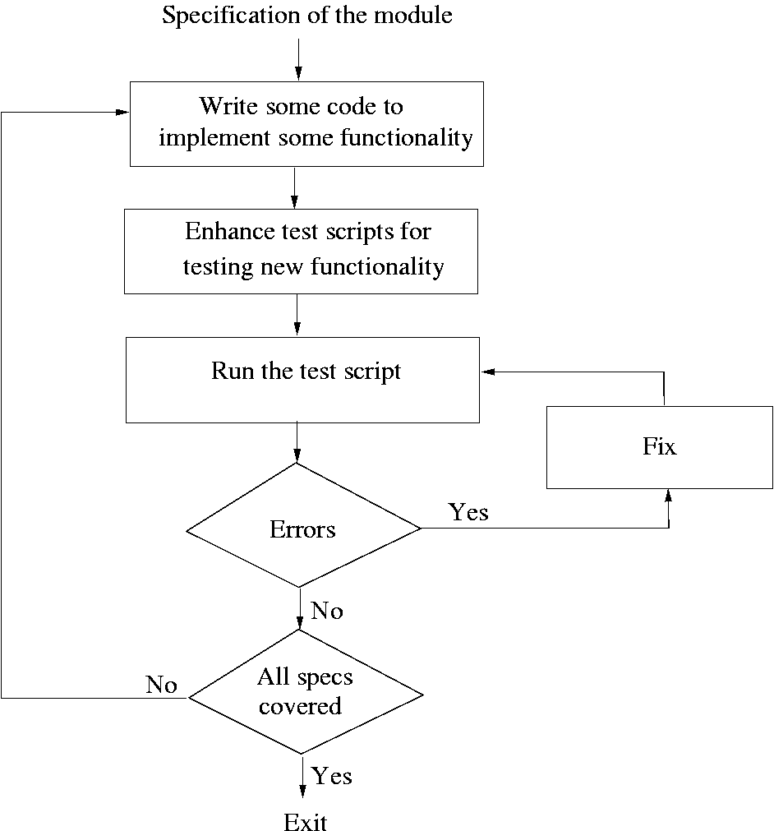
Coding

Slide 29
Test Driven Development
This coding process changes the order of activities in coding
In TDD, programmer first writes the test scripts and then writes the code to pass the test cases in the script
This is done incrementally
Is a relatively new approach, and is a part of the extreme programming (XP)
Coding

Slide 30
TDD…
In TDD, you write just enough code to pass the test
I.e. code is always in sync with the tests and gets tested by the test cases
  Not true in code first approach, as test cases may only test part of functionality
Responsibility to ensure that all functionality is there is on test case design, not coding
Help ensure that all code is testable
Coding

Slide 31
TDD…
Focus shifts to how code will be used as test cases are written first
  Helps validate user interfaces specified in the design
  Focuses on usage of code
Functionality prioritization happens naturally
Has possibility that special cases for which test cases are not possible get left out
Code improvement through refactoring will be needed to avoid getting a messy code
Coding

Slide 32
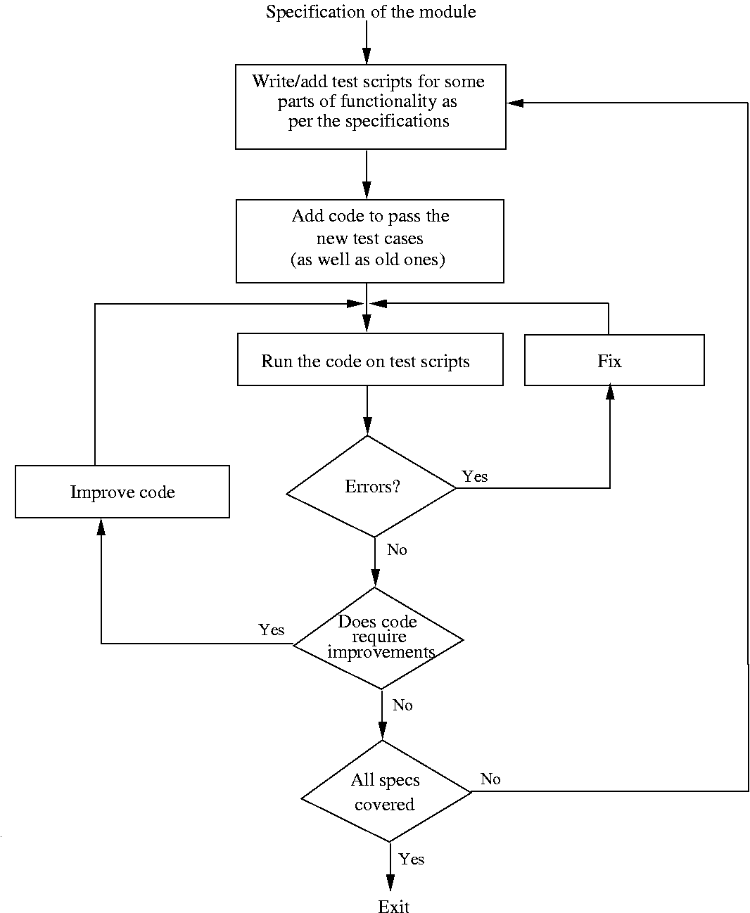
Coding

Slide 33
Pair Programming
Also a coding process that has been proposed as key practice in XP
Code is written by pair of programmers rather than individuals
  The pair together design algorithms, data structures, strategies, etc.
  One person types the code, the other actively reviews what is being typed
  Errors are pointed out and together solutions are formulated
  Roles are reversed periodically
Coding

Slide 34
Pair Programming…
PP has continuous code review, and reviews are known to be effective
Better designs of algos/DS/logic/…
Special conditions are likely to be dealt with better and not forgotten
It may, however, result in loss of productivity
Ownership and accountability issues are also there
Effectiveness is not yet fully known
Coding

Slide 35
Managing Evolving Code
During coding process, code written by a programmer evolves
Code by different programmers have to be put together to form the system
Besides normal code changes, requirement changes also cause chg.
Evolving code has to be managed
Coding

Slide 36
Source Code Control and Built
Source code control is an essential step programmers have to do
Generally tools like CVS, VSS are used
A tool consists of repository, which is a controlled directory structure
The repository is the official source for all the code files
System build is done from the files in the repository only
Tool typically provides many commands to programmers
Coding

Slide 37
Source code control…
Checkout a file: by this a programmer gets a local copy that can be modified
Check in a file: changed files are uploaded in the repository and change is then available to all
Tools maintain complete change history and all older versions can be recovered
Source code control is an essential tool for developing large projects and for coordination
Coding

Slide 38
Refactoring
As code evolves, the design becomes more complex
Refactoring is a technique to improve existing code by improving its design (i.e. the internal structure)
In TDD, refactoring is a key step
Refactoring is done generally to reuce coupling or increase cohesion
Coding

Slide 39
Refactoring…
Involves changing code to improve some design property
No new functionality is added
To mitigate risks associated with refactoring two golden rules
  Refactor in small steps
  Have test scripts available to test that the functionality is preserved
Coding

Slide 40
Refactoring…
With refactoring code is continually improving; refactoring cost is paid by reduced maint effort later
There are various refactoring patterns that have been proposed
A catalog of refactorings and how to do them is available online
Coding

Slide 41
Refactoring…
refactoring may be desired
  Duplicate code
  Long method
  Long class
  Long parameter list
  Swith statement
  Speculative generality
  Too much communication between objects
  …
Coding

Slide 42
Unit Testing
Coding

Slide 43
UT and Verification
Code has to be verified before it can be used by others
Here we discuss only verification of code written by a programmer (system verification is discussed in testing)
There are many different techniques – two most commonly used are unit testing and inspection
We will discuss these here
Coding

Slide 44
Unit Testing
Is testing, except the focus is the module a programmer has written
Most often UT is done by the programmer himself
UT will require test cases for the module – will discuss in testing
UT also requires drivers to be written to actually execute the module with test cases
Besides the driver and test cases, tester needs to know the correct outcome as well
Coding

Slide 45
Unit Testing…
If incremental coding is being done, then complete UT needs to be automated
Otherwise, repeatedly doing UT will not be possible
There are tools available to help
  They provide the drivers
  Test cases are programmed, with outcomes being checked in them
  I.e. UT is a script that returns pass/fail
Coding

Slide 46
Unit Testing…
Testing a module f() has following steps
  Set the system state as needed
  Set value of parameters suitably
  Invoke the function f() with parms
  Compare result of f() with expected results
  Declare whether the test case succeeded or failed
Test frameworks automate all this
Coding

Slide 47
Unit testing of Classes
Is same as before, except the system state is generally the state of the object
Many frameworks exist for OO – Junit is the most popular; others for other languages also exist
Each testcase is a method, in which the desired sequence of methods is executed; assertions used to check the outcome
The script will declare if all tests succeeded, and if not which ones have failed
Coding

Slide 48
Unit Testing…
There are frameworks like Junit that can be used for testing Java classes
Each test case is a method which ends with some assertions
If assertions hold, the test case pass, otherwise it fails
Complete execution and evaluation of the test cases is automated
For enhancing the test script, additional test cases can be added easily
Coding

Slide 49
Code Inspections
Code inspection is another technique that is often used effectively at the unit level
Main goal of inspection process is to detect defects in work products
First proposed by Fagan in 70s
Earlier used for code, now used for all types of work products
Is recognized as an industry best practice
Coding

Slide 50
Code review…
Conducted by group of programmers for programmers (i.e. review done by peers)
Is a structured process with defined roles for the participants
The focus is on identifying problems, not resolving them
Review data is recorded and used for monitoring the effectiveness
Coding

Slide 51
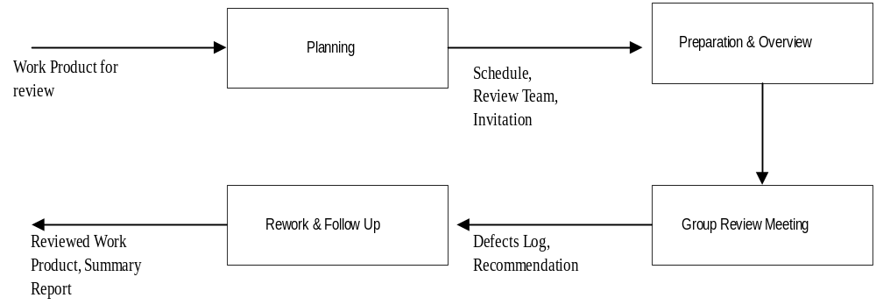
A Review Process
Coding

Slide 52
Planning
Select the group review team – three to five people group is best
Identify the moderator – has the main responsibility for the inspection
Prepare package for distribution – work product for review plus supporting docs
Package should be complete for review
Coding

Slide 53
Overview and Self-Review
A brief meeting – deliver package, explain purpose of the review, intro,…
All team members then individually review the work product
  Lists the issues/problems they find in the self-preparation log
  Checklists, guidelines are used
Ideally, should be done in one sitting and issues recorded in a log
Coding

Slide 54
Self-Review Log
Project name:
Work product name and ID:
Reviewer Name
Effort spent (hours)
Defect list
  No Location Description Criticality
Coding

Slide 55
Group Review Meeting
Purpose – define the final defect list
Entry criteria – each member has done a proper self-review (logs are reviewed)
Group review meeting
  A reviewer goes over the product line by line
  At any line, all issues are raised
  Discussion follows to identify if a defect
  Decision recorded (by the scribe)
Coding

Slide 56
Group Review Meeting…
At the end of the meeting
  Scribe presents the list of defects/issues
  If few defects, the work product is accepted; else it might be asked for another review
  Group does not propose solutions – though some suggestions may be recorded
  A summary of the inspections is prepared – useful for evaluating effectiveness
Coding

Slide 57
Group Review Meeting…
Moderator is in-charge of the meeting and plays a central role
  Ensures that focus is on defect detection and solutions are not discussed/proposed
  Work product is reviewed, not the author of the work product
  Amicable/orderly execution of the meeting
  Uses summary report to analyze the overall effectiveness of the review
Coding

Slide 58
Summary Report Example
Project Work Product Type Size of work product Review team Effort (person hours) Preparation Group meeting Total | XXXX Class AuctionItem 250 LOC of Java P1, P2, P3 3 person-hrs (total) 4.5 person-hrs 7.5
Coding

Slide 59
Summary Report…
Defects No of major defects No of minor defects Total Review status Reco for next phase Comments | 3 8 11 Accepted Nil Code can be improved
Coding

Slide 60
Summary Report…
Defect density found – 3/0.25 = 12 major defects/KLOC
  Seems OK from experience
  Similarly for total and minor density
Preparation rate – about 250/1 = 250 LOC / hr : Seems OK
Group review rate: 250/1.5 = 180 LOC/hr; seems OK
Coding

Slide 61
Rework and Follow Up
Defects in the defects list are fixed later by the author
Once fixed, author gets it OKed by the moderator, or goes for another review
Once all defects/issues are satisfactorily addressed, review is completed and collected data is submitted
Coding

Slide 62
Metrics
Coding

Slide 63
Metrics for Size
LOC or KLOC
  non-commented, non blank lines is a standard definition
  Generally only new or modified lines are counted
  Used heavily, though has shortcomings
Coding

Slide 64
Metrics for Size…
Halstead’s Volume
  n1: no of distinct operators
  n2: no of distinct operands
  N1: total occurrences of operators
  N2: Total occurrences of operands
  Vocabulary, n = n1 + n2
  Length, N = N1 + N2
  Volume, V = N log₂(n)
Coding

Slide 65
Metrics for Complexity
Cyclomatic Complexity is perhaps the most widely used measure
Represents the program by its control flow graph with e edges, n nodes, and p parts
Cyclomatic complexity is defined as V(G) = e-n+p
This is same as the number of linearly independent cycles in the graph
And is same as the number of decisions (conditionals) in the program plus one
Coding

Slide 66
Cyclomatic complexity example…
{
i=1;
while (i<=n) {
J=1;
while(j <= i) {
If (A[i]<A[j])
Swap(A[i], A[j]);
J=j+1;}
i = i+1;}
}
Coding

Slide 67
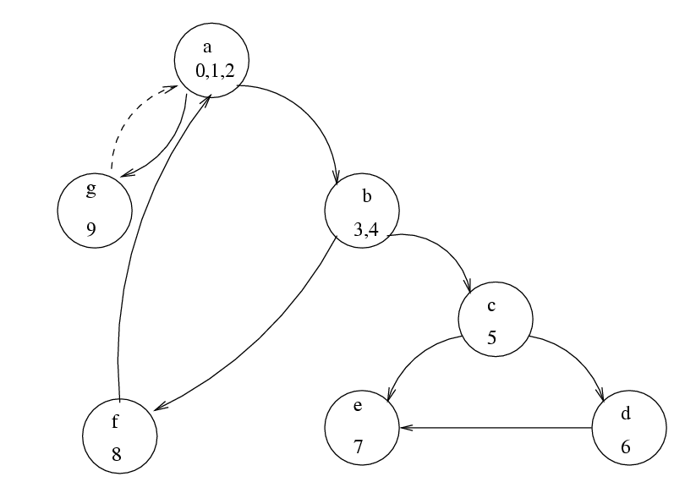
Example…
Coding

Slide 68
Example…
V(G) = 10-7+1 = 4
Independent circuits
  b c e b
  b c d e b
  a b f a
  a g a
No of decisions is 3 (while, while, if); complexity is 3+1 = 4
Coding

Slide 69
Complexity metrics…
Halsteads
  N2/n2 is avg times an operand is used
  If vars are changed frequently, this is larger
  Ease of reading or writing is defined as
  D = (n1*N2)/(2*n2)
There are others, e.g. live variables, knot count..
Coding

Slide 70
Complexity metrics…
The basic use of these is to reduce the complexity of modules
One suggestion is that cyclomatic complexity should be less than 10
Another use is to identify high complexity modules and then see if their logic can be simplified
Coding

Slide 71
Summary
Goal of coding is to convert a design into easy to read code with few bugs
Good programming practices like structured programming, information hiding, etc can help
There are many methods to verify the code of a module – unit testing and inspections are most commonly used
Size and complexity measures are defined and often used; common ones are LOC and cyclomatic complexity
Coding

